Slide 1
Presentation
on
Shaheed Minar
Under Guidelines Of
Asif Hossain Khan
Lecturer Dept. Of Computer Science and Engineering, DIU
Presented By-
Akash Mia
ID: 192-15-2860
Course Code: CSE 221
Course Title: Theory of Computing
Dept. of CSE , DIU

Slide 2

Shaeed Minar
Shaeed Minar is a national monument in Dhaka, Bangladesh, established to commemorate those killed during the Bengali Language Movement demonstrations of 1952 in then East Pakistan.

Slide 3
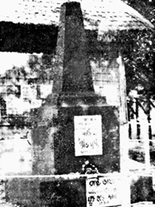
Why Shaeed Minar is a Historical Place?
Shaheed Minar monument built in memory of the mother language martyrs, who were killed on 21st February 1952 during the language movement. A memorial to the martyrs was built immediately after the killings, on 23 February 1952. So, Shaheed Minar is a historical place

Slide 4
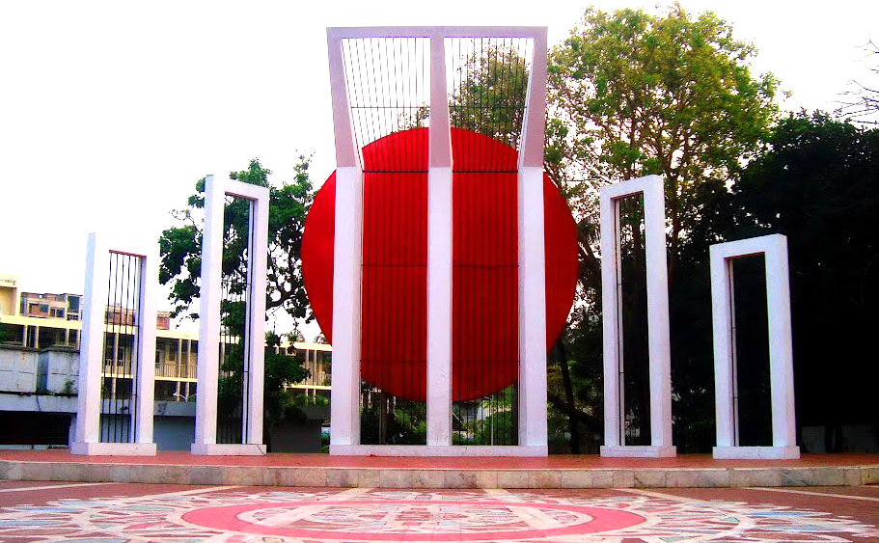
Why Shaeed Minar is a Historical Place?
Shaheed Minar(1952)
Shaheed Minar(1972)

Slide 5
Background of Shaheed Minar
On 21 and 22 February 1952, students from Dhaka University and Dhaka Medical College and political activists were killed when the Pakistani police force opened fire on Bengali protesters who were demanding official status for their native tongue, Bengali. The massacre occurred near Dhaka Medical College and Ramna Park in Dhaka. A makeshift monument was erected on 23 February by students of Dhaka medical college and other educational institutions, but soon demolished on 26 February by the Pakistani police force. The Language Movement gained momentum, and after a long struggle, Bengali gained official status in Pakistan (with Urdu) in 1956.

Slide 6
Background of Shaheed Minar
To commemorate the dead, the Shaheed Minar was designed and built by Bangladeshi sculptors Hamidur Rahman in collaboration with Novera Ahmed. Construction was delayed by martial law, but the monument was finally completed in 1963, and stood until the Bangladesh Liberation War in 1971, when it was demolished completely during Operation Searchlight. After Bangladesh gained independence later that year, it was rebuilt. It was expanded in 1983. National, mourning, cultural and other activities are held each year on 21 February (Ekushey February) to mark Language Movement Day or Shaheed Dibas (Martyrs' Day), centered on the Shaheed Minar. Since 2000, 21 February is also recognized as International Mother Language Day.

Slide 7
Visiting Area
The Shaheed Minar is a place where people pay homage to the martyrs with flowers. The Shaheed Minar is situated near Dhaka Medical College Hospital and in the Dhaka University area. It is adjacent to the Mathematics Department of Dhaka University. Doel Square is one of the popular areas of the University of Dhaka campus located in Shahbag near Central Shaheed Minar. There is sculpture of Oriental magpie-robin in the middle of the Doel Square. The oriental magpie-robin is the national bird of Bangladesh and locally known as the doyel or doel.

Slide 8
Thank you

